Slide 1
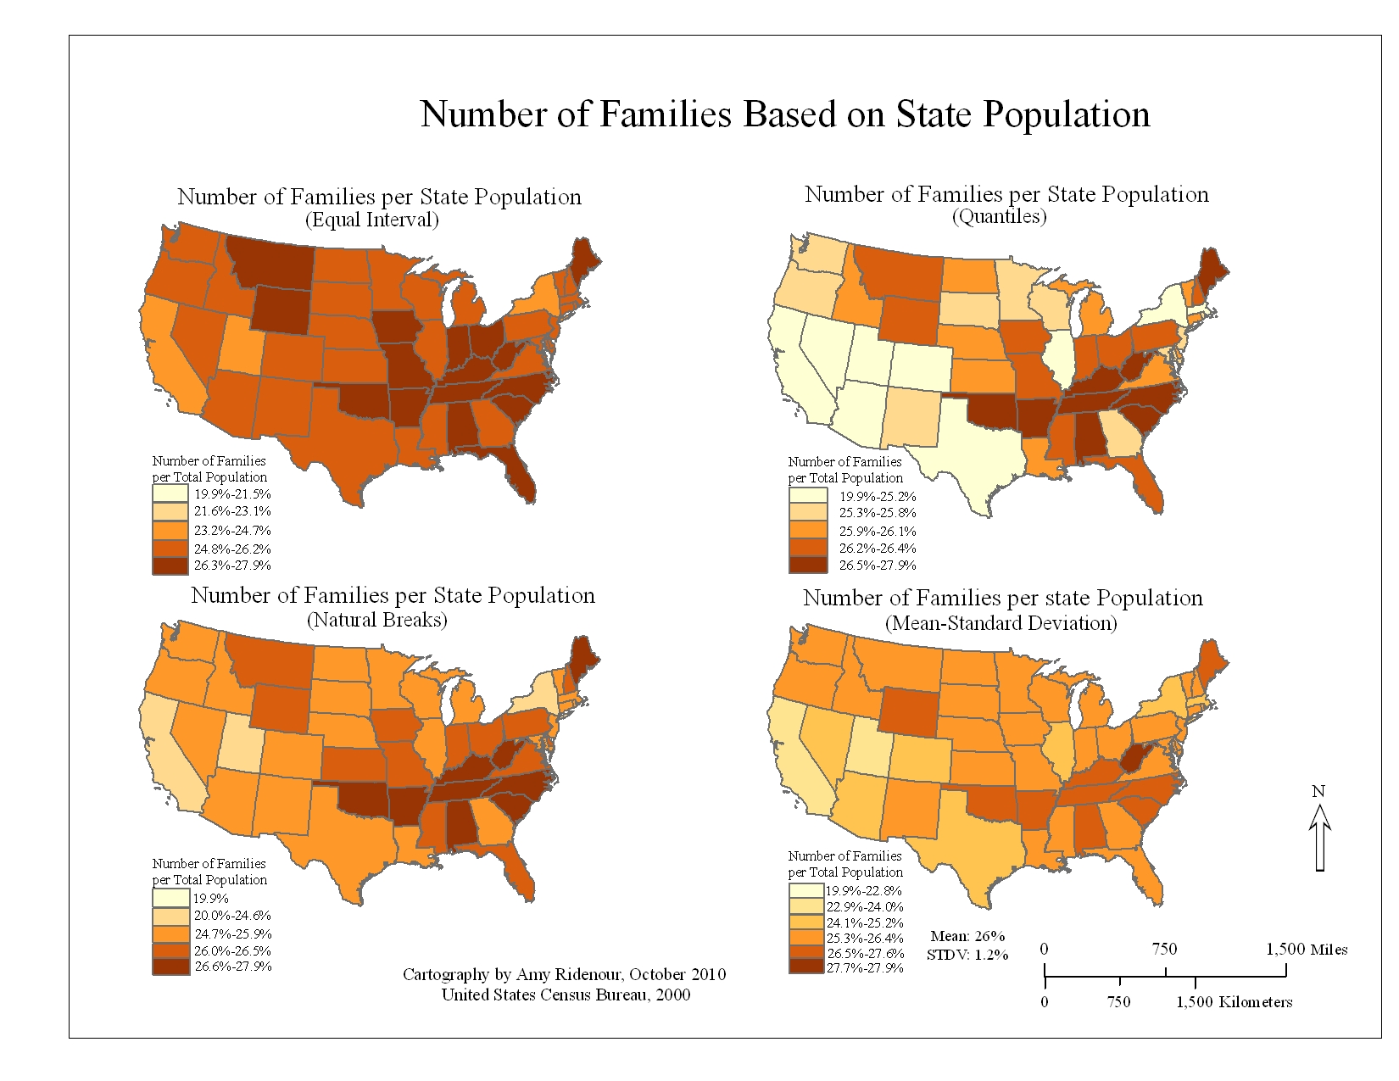
Data classification and central tendency
Geog4300/6300
Jerry Shannon

Slide 2
Central tendency: mean
Mean: the average value, represented by x
x = [x₁+x₂+x₃+x₄…x_{n}] / n
the “nth” observation
# of cars through an intersection
Minute | 1 | 2 | 3 | 4 | 5
# of cars | 25 | 51 | 29 | 14 | 13
X = (25 + 51 + 20 + 14 + 13) / 5 = 26.4 cars/min.

Slide 3
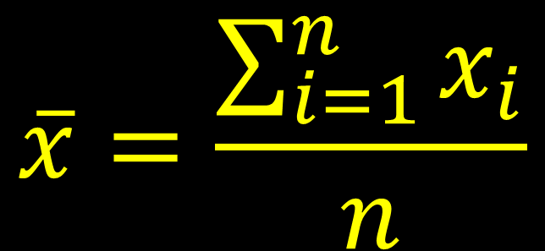
The mean (defined through notation)
“the mean is the sum of all values of x from the first observation to the nth observation, all divided by n.”
$$\overline{x}=\frac{\sum_{i=1}^{n}{x_{i}}}{n}$$

Slide 4
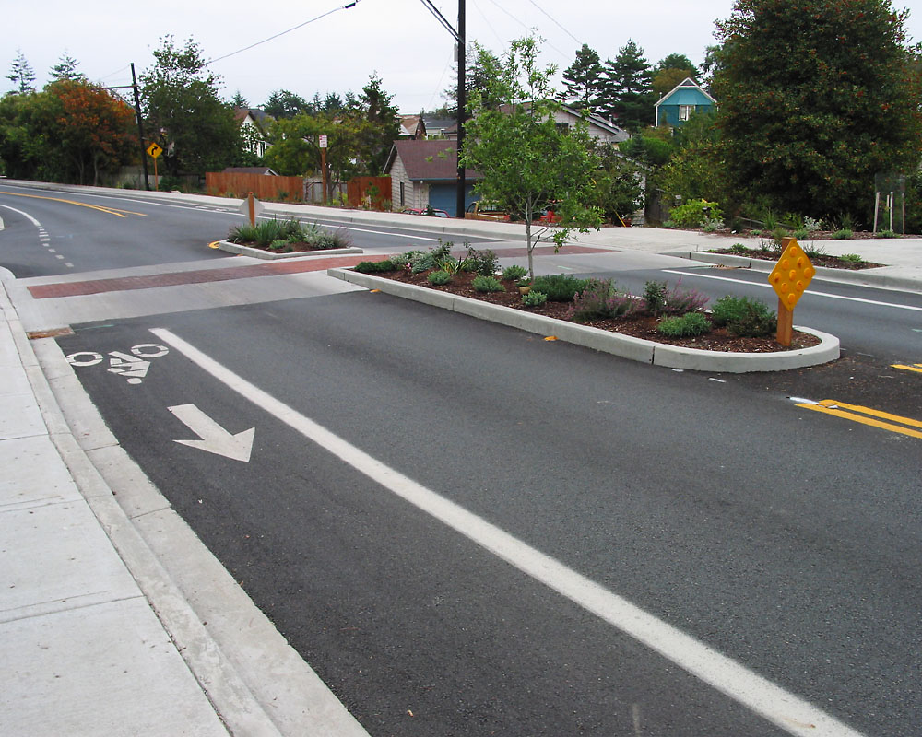
Median
A positional value in the data set: the median is the value that has the same number of smaller values as larger values
a.k.a. the 50th percentile

Slide 5
Finding the Median
Order (sort) the data from smallest to largest
Minute | 1 | 2 | 3 | 4 | 5
# of cars | 25 | 51 | 29 | 14 | 13
Minute | 5 | 4 | 1 | 3 | 2
# of cars | 13 | 14 | 25 | 29 | 51
if n is odd, choose the middle data value
if n is even, take the average of the middle two values

Slide 6
Mode
The mode is the most frequent value.
A variable can have more than one mode, or no mode.
Color of cars observed in minute 4
Blue Green Red
Red Grey Black
Black Black White
Red Green Grey
Silver Red

Slide 7
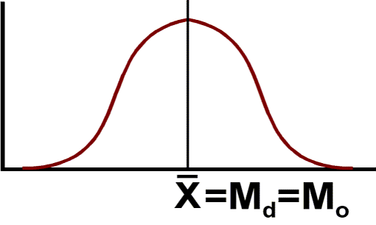
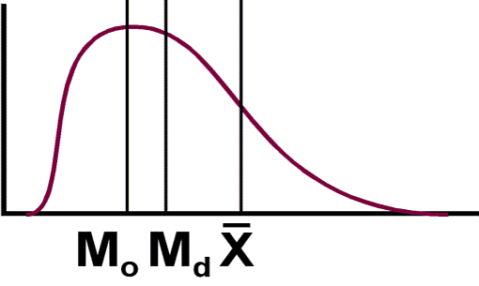
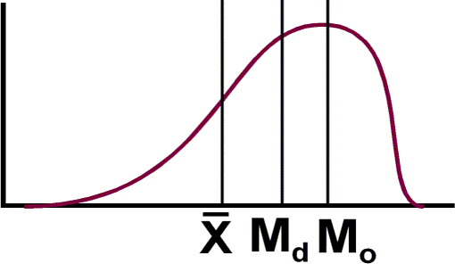
When to use…
Mean: Interval and ratio data, when normally distributed
Median: Ordinal data (or skewed/non-normal data)
Mode: Nominal data

Slide 8
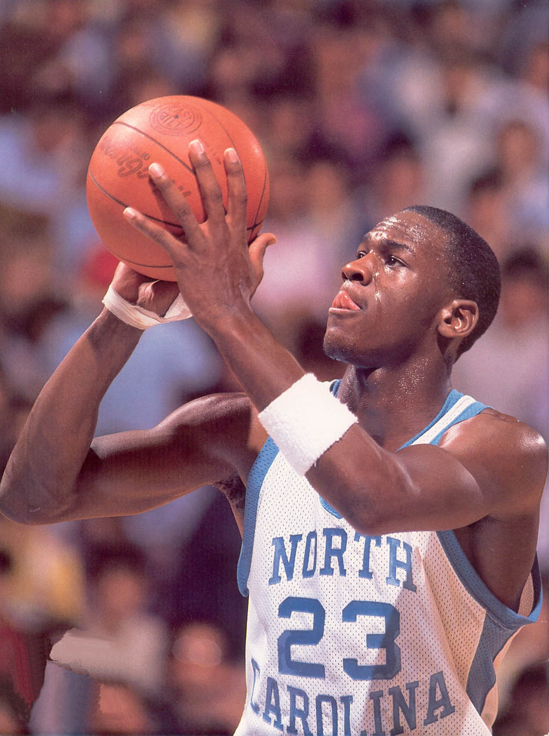
In 1987, the mean salary for graduating geography majors from U. of North Carolina was reported to be over $100,000 per year. Why?
The median income would have been much closer to what the other geographers made…

Slide 9
Calculate the mean, median and mode for the following three census variables in Excel:
LessHS_pct (% with hs degree)
GradDeg_pct (% with graduate degree)
nat_ins_pct (% of naturalized citizens with health insurance)
Which one is best?
Calculating in Excel
=AVERAGE()
=MEDIAN()
=MODE()

Slide 10
Lecture break

Slide 11
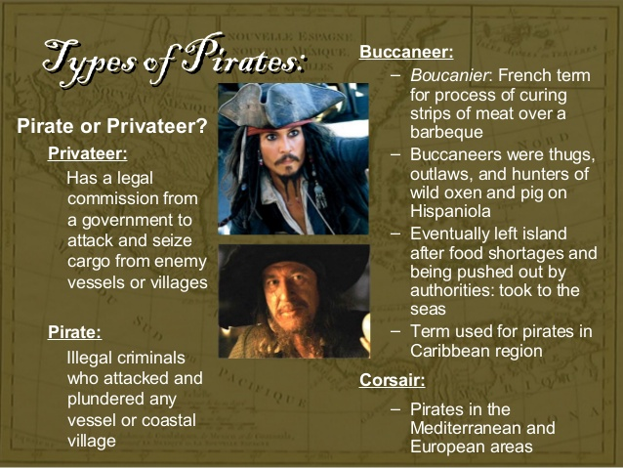
Why is classification necessary?
It brings order to unruly data
Helps communicate findings
Suggests research questions

Slide 12
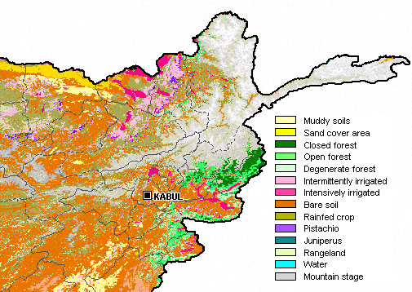
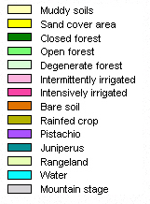
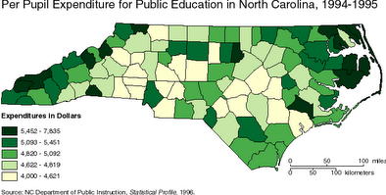
Notes:
What levels of measurement do each of these maps show?
Classification can happen with several different kinds of data.

Slide 13
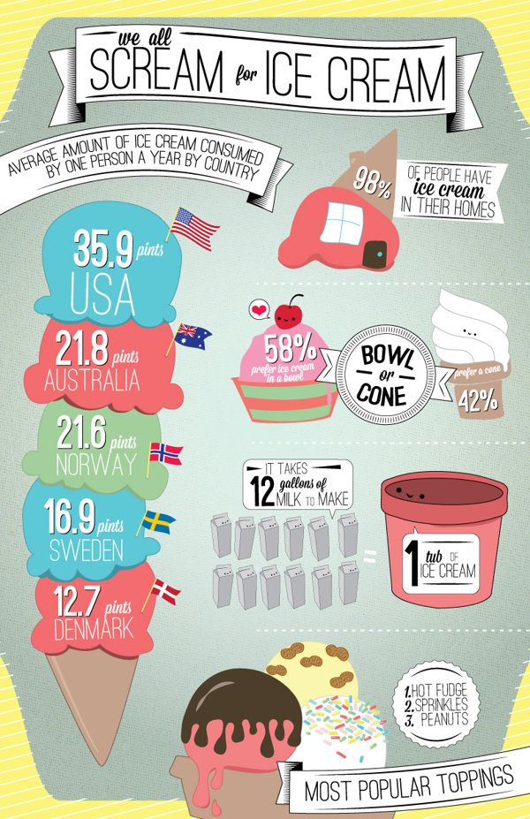
Categorical classification schemes
What’s your favorite flavor of ice cream?
How could we classify these?
Notes:
Here’s a dotplot of graduation rate in Georgia counties (created in R using Deducer). What do you notice about it just looking at it?
How could we classify it?

Slide 14
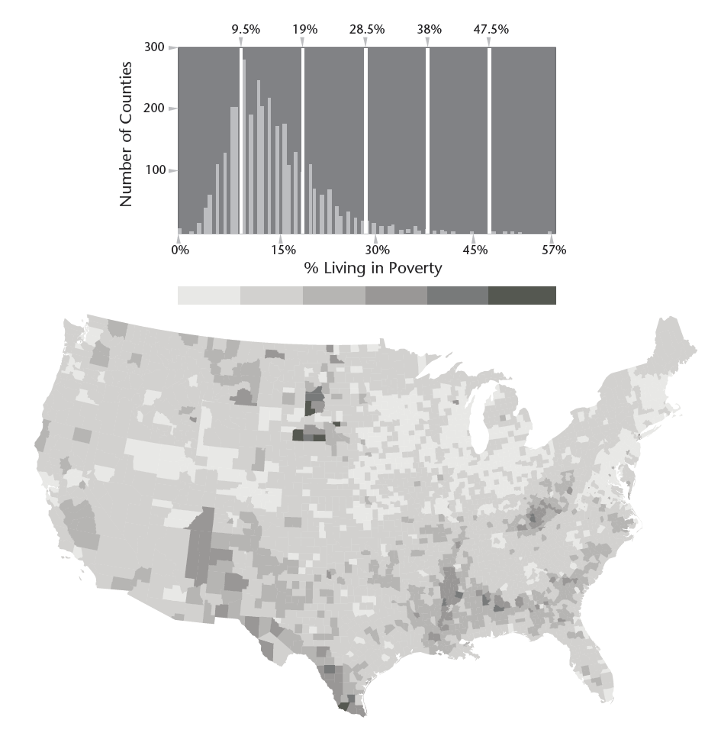
Numeric Classification schemes
Equal interval
Quantile
Natural Breaks
Notes:
Depending your approach, classification methods can paint very different pictures of the same data points.
How might we interpret the natural breaks map differently from the quantiles map here?

Slide 15
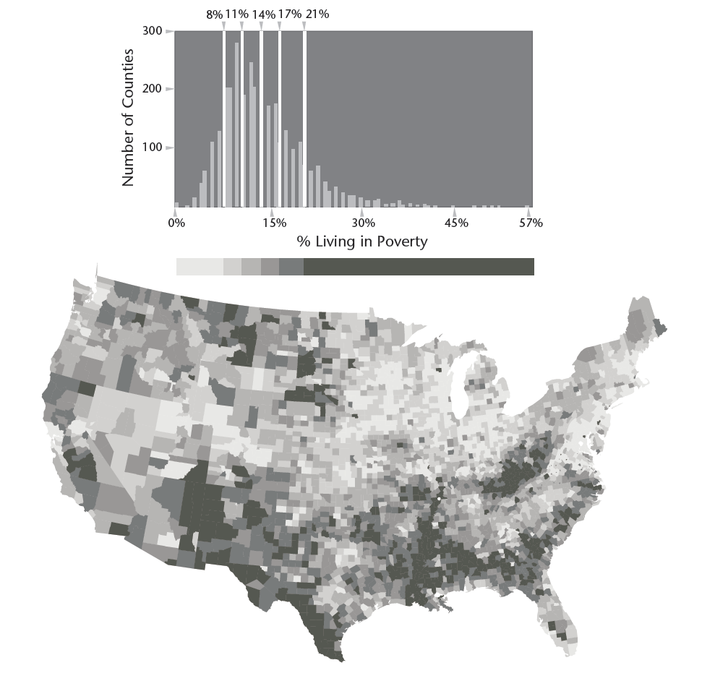
Numeric Classification schemes
Equal interval
Quantile
Natural Breaks
Notes:
Depending your approach, classification methods can paint very different pictures of the same data points.
How might we interpret the natural breaks map differently from the quantiles map here?

Slide 16
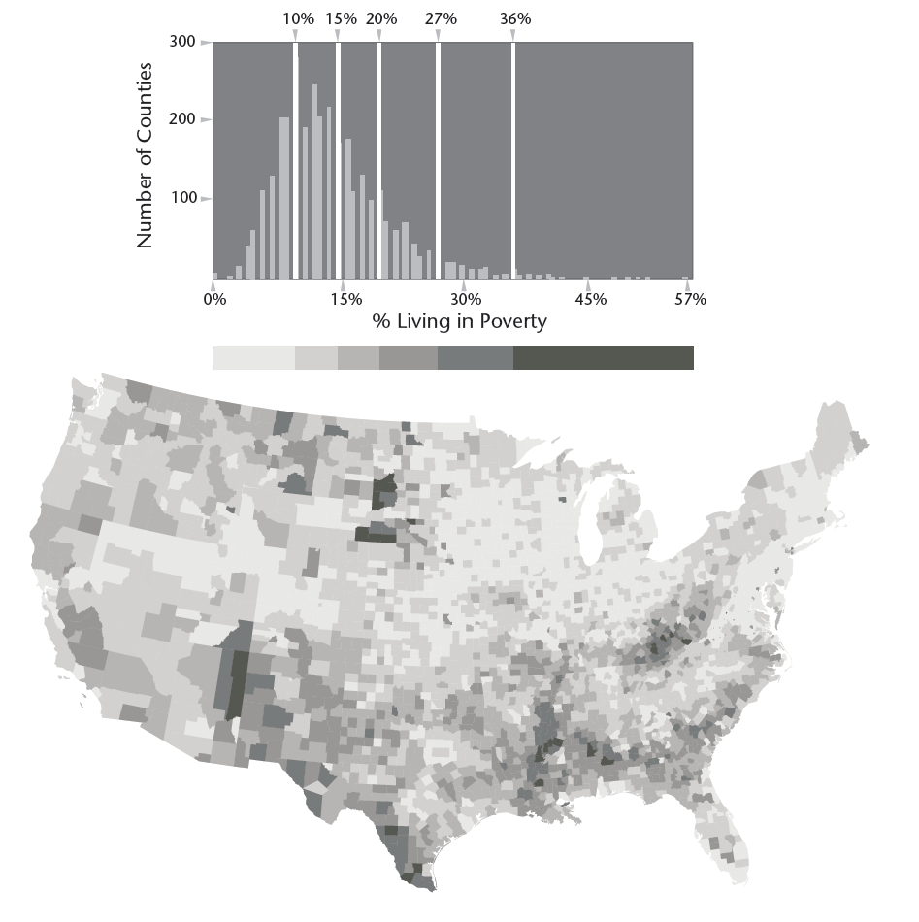
Numeric Classification schemes
Equal interval
Quantile
Natural Breaks
Notes:
Depending your approach, classification methods can paint very different pictures of the same data points.
How might we interpret the natural breaks map differently from the quantiles map here?

Slide 17
Numeric Classification schemes
Equal interval
Quantile
Natural Breaks
Choose based on your data and the analysis you’re doing
Notes:
Depending your approach, classification methods can paint very different pictures of the same data points.
How might we interpret the natural breaks map differently from the quantiles map here?

Slide 18
You try it!
Load the census data in R. Which classification scheme is best for the % BADeg variable in our census data? Why?
Equal interval
Quantile
Natural Breaks
Notes:
Depending your approach, classification methods can paint very different pictures of the same data points.
How might we interpret the natural breaks map differently from the quantiles map here?

Slide 19
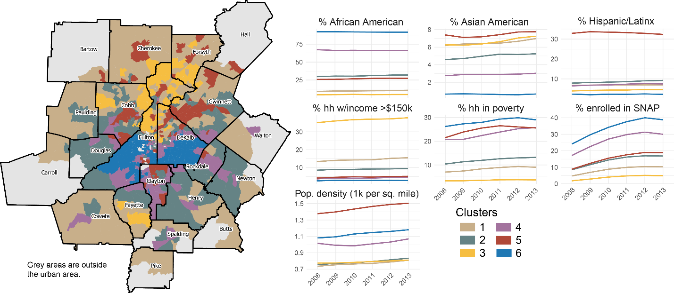
Clustering
K-means and HCA can identify clusters based on multiple attributes

Slide 20
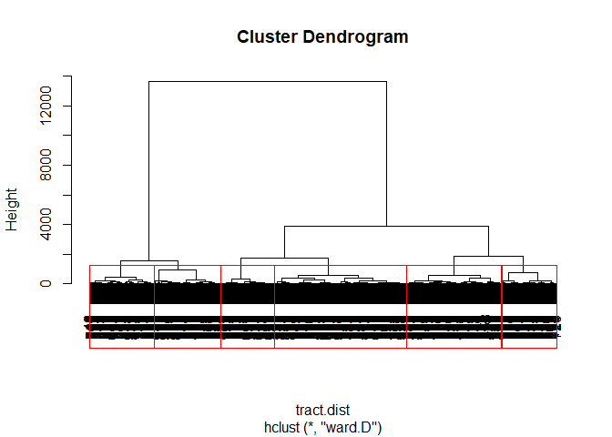
Clustering
K-means and HCA can identify clusters based on multiple attributes

